Slide 1
Famous Leaders A-Z
By Kaia Frazerhurst

Slide 2
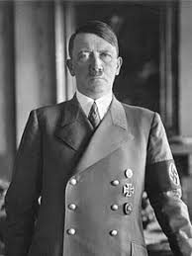
A - Adolf Hitler
Adolf Hitler was a German politician who was the leader of the Nazi Party. As dictator, he initiated World War II and was responsible for around six million Jews being killed in the Holocaust. The victims including 1.5 million children.

Slide 3
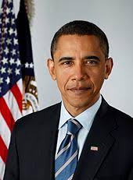
B - Barack Obama
Barack Obama was the 44th president of America. He is the first African American to become president. He has recently finished his job working at the White House and Donald J. Trump has taken over.

Slide 4
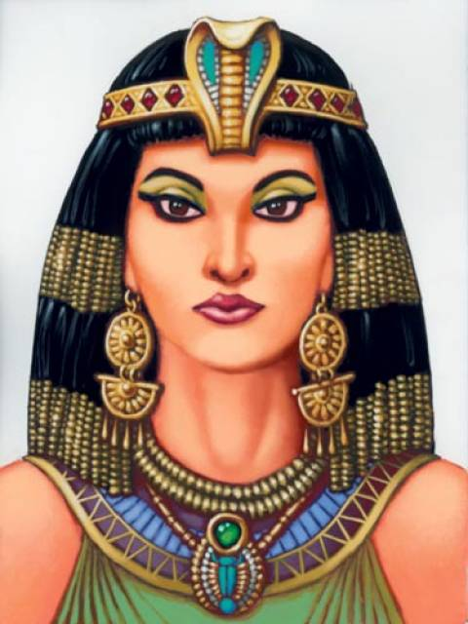
C - Cleopatra VII
Cleopatra VII Queen of Egypt. Cleopatra was the last pharaoh before Egypt was conquered by Romans. She was a powerful leader and ruler of Egypt.

Slide 5
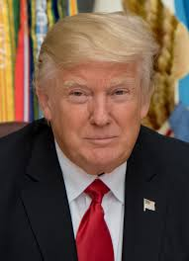
D - DONALD J. TRUMP
Donald John Trump is the 45th and current President of the United States. Before entering politics, he was a businessman and television personality.

Slide 6
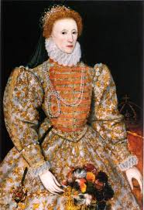
E -Elizabeth I
Elizabeth I was Queen of England and Ireland from 17 November 1558 until her death. Childless Elizabeth was the last monarch of the House of Tudor.

Slide 7
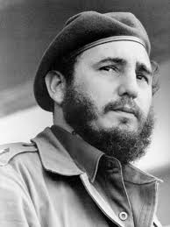
F - Fidel Castro
Fidel Alejandro Castro Ruz was a Cuban revolutionary and politician who governed the Republic of Cuba as Prime Minister from 1959 to 1976 and then as President from 1976 to 2008.

Slide 8
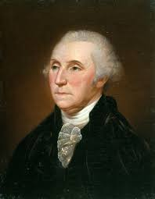
G - George Washington
George Washington was an American politician and soldier who served as the first President of the United States from 1789 to 1797 and was one of the Founding Fathers of the United States.

Slide 9
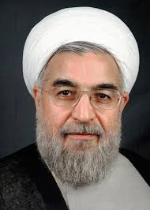
H - Hassan Rouhani
Hassan Rouhani is the seventh and current President of Iran, a position he has held since 2013. He is also a lawyer, academic, former diplomat and Islamic cleric.

Slide 10
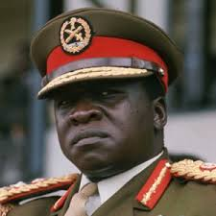
I - Idi Amin
Idi Amin Dada was a Ugandan political leader and military officer who was the President of Uganda from 1971 to 1979.

Slide 11
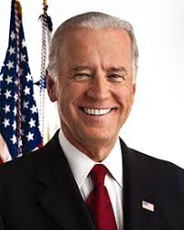
J - Joe Biden
Joe Biden is an American politician who was the 47th Vice President of the United States from 2009 to 2017, having been jointly elected twice with President Barack Obama. A member of the Democratic Party, he represented Delaware as a United States Senator from 1973 until becoming Vice President in 2009.

Slide 12
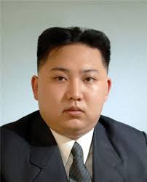
K - Kim Jong-Un
Kim Jong-un is the Chairman of the Workers' Party of Korea (WPK) and supreme leader of the Democratic People's Republic of Korea (DPRK), commonly referred to as North Korea.

Slide 13
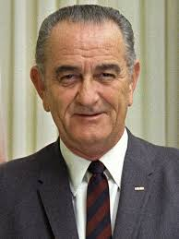
L - Lyndon B. Johnson
Lyndon Baines Johnson, often referred to as LBJ, was an American politician who served as the 36th President of the United States from 1963 to 1969, assuming the office after serving as the 37th Vice President of the United States under President John F. Kennedy from 1961 to 1963.

Slide 14
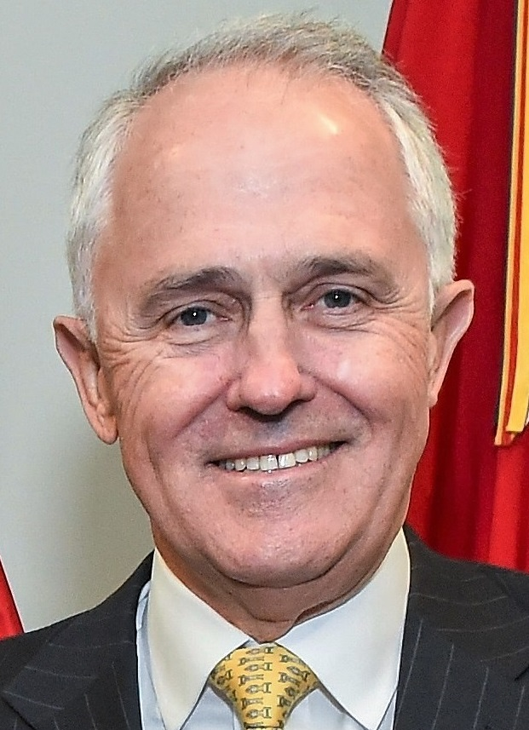
M - Malcolm Turnbull
Malcolm Turnbull is the 29th and current prime minister of Australia. He first served as parliamentary leader of the Liberal Party of Australia and as opposition leader from 2008 to 2009, and became parliamentary leader and Prime Minister after defeating Tony Abbott at the 2015 Liberal leadership spill.

Slide 15
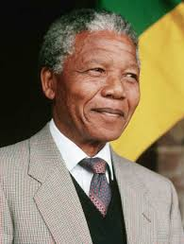
N - Nelson Mandela
Nelson Rolihlahla Mandela was a South African anti-apartheid revolutionary, politician, and philanthropist, who served as President of South Africa from 1994 to 1999. He was the country's first black head of state and the first elected in a fully representative democratic election.

Slide 16
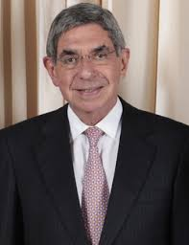
O - Óscar Arias
Óscar Arias Sánchez was President of Costa Rica from 1986 to 1990 and from 2006 to 2010. He received the Nobel Peace Prize in 1987 for his efforts to end the Central American crisis.

Slide 17
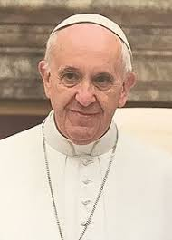
P - Pope Francis
Pope Francis is the 266th and current Pope of the Roman Catholic Church, a title he holds ex officio as Bishop of Rome, and sovereign of Vatican City.

Slide 18
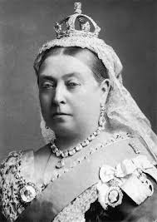
Q - Queen Victoria
Victoria was Queen of the United Kingdom of Great Britain and Ireland from 20 June 1837 until her death. From 1 May 1876, she adopted the additional title of Empress of India.

Slide 19
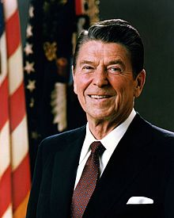
R - Ronald Reagan
Ronald Wilson Reagan was an American politician and actor who served as the 40th President of the United States from 1981 to 1989. Before his presidency, he was the 33rd Governor of California, from 1967 to 1975, after a career as a Hollywood actor and union leader.

Slide 20
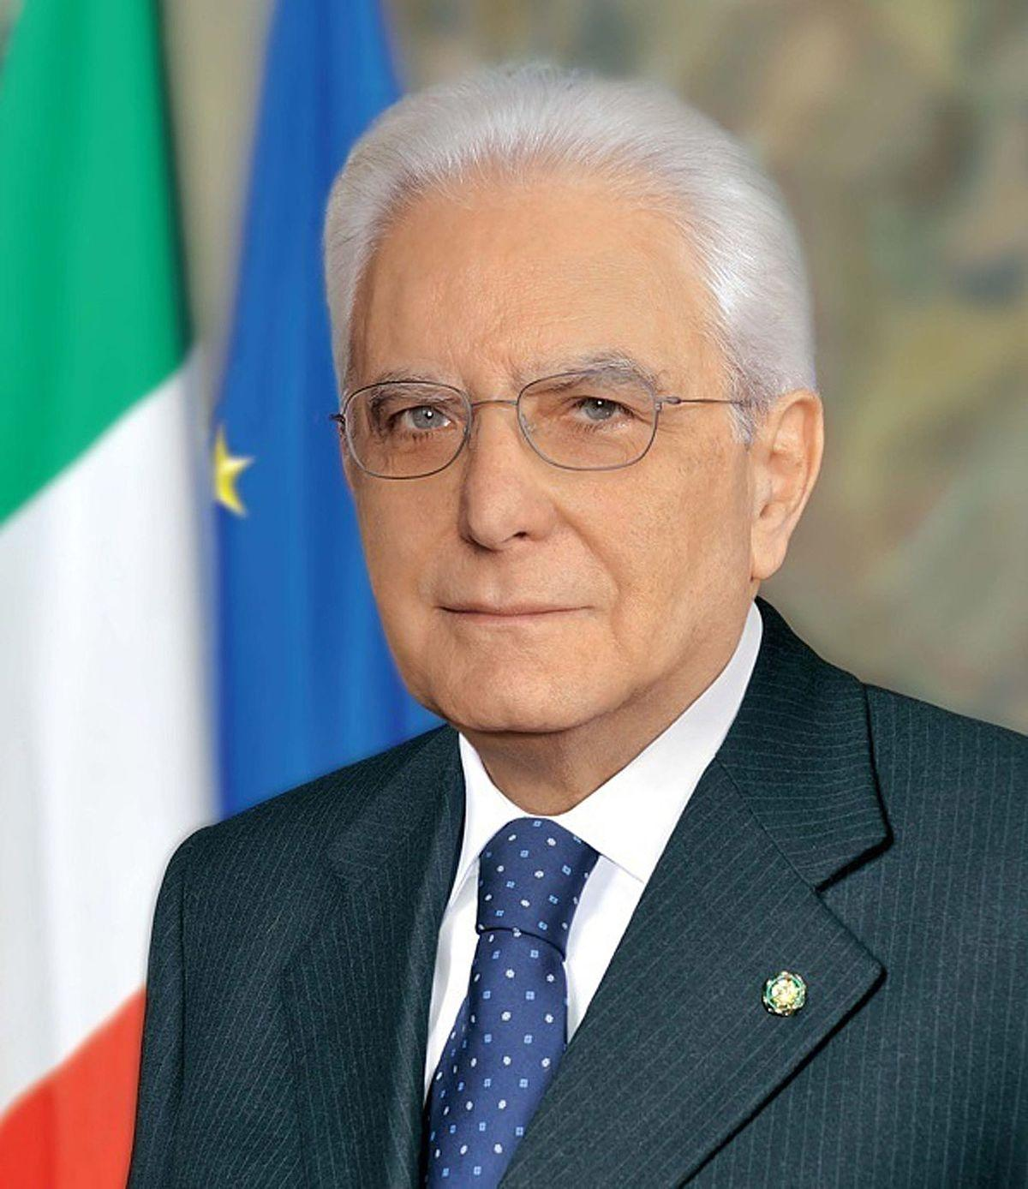
S - Sergio Mattarella
Sergio Mattarella is an Italian politician, lawyer and judge who is the 12th and current President of Italy and has been since 2015.

Slide 21
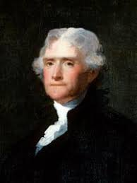
T - Thomas Jefferson
Thomas Jefferson was an American Founding Father who was the principal author of the Declaration of Independence and later served as the third President of the United States from 1801 to 1809. Previously, he was elected the second Vice President of the United States, serving under John Adams from 1797 to 1801.

Slide 22
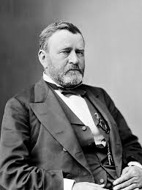
U - Ulysses S. Grant
Ulysses S. Grant, born Hiram Ulysses Grant, was the 18th President of the United States (1869-77). As Commanding General (1864–69), Grant worked closely with President Abraham Lincoln to lead the Union Army to victory over the Confederacy in the American Civil War.

Slide 23
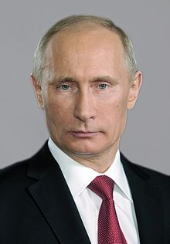
V - Vladimir Putin
Vladimir Vladimirovich Putin is the current President of Russia, holding the office since 7 May 2012. He was Prime Minister from 1999 to 2000, President from 2000 to 2008, and again Prime Minister from 2008 to 2012.

Slide 24
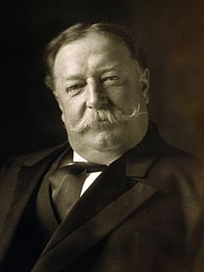
W - William Howard Taft
William Howard Taft served as the 27th President of the United States from 1909 to 1913 and as the tenth Chief Justice of the United States from 1921 to 1930. He was the only person to have held both offices.

Slide 25
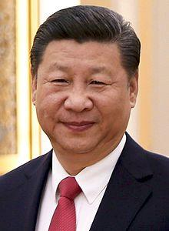
X - Xi Jinping
Xi Jinping is a Chinese politician. He is the current General Secretary of the Communist Party of China, President of the People's Republic of China, and Chairman of the Central Military Commission.

Slide 26
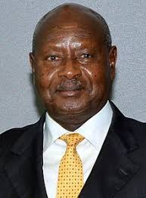
Y - Yoweri Museveni
Yoweri Kaguta Museveni is a Ugandan politician who is the 9th and current President of Uganda. He has been President since 29 January 1986.

Slide 27
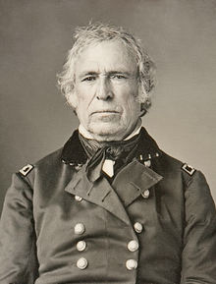
Z - Zachary Taylor
Zachary Taylor was the 12th President of the United States, serving from March 1849 until his death in July 1850. Before his presidency, Taylor was a career officer in the United States Army, rising to the rank of major general.

