Slide 1
Famous Leaders A-Z
By Thornton 8WH

Slide 2
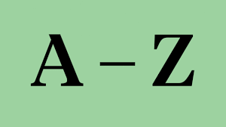
Here is a list of leaders that I have put together. I have tried to make them the easiest to recognise. I hope you enjoy.

Slide 3
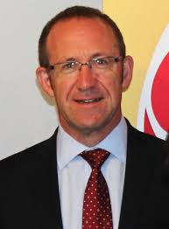
A-Andrew Little
Andrew Little is a New Zealand politician. He resigned in 2017 from being leader of the Labour party.

Slide 4
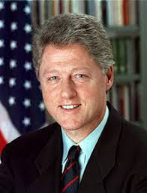
B-Bill Clinton
Bill Clinton is an American politician who served as the 42nd President of the United States from 1993 to 2001. He has a wife who ran for President in 2017, she is Hillary Clinton.

Slide 5
C-Christopher Columbus
Christopher Columbus is a well known explorer who was born in Italy and made four known trips across the Atlantic. He is a leader because he navigated the ships he sailed on.

Slide 6
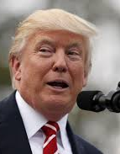
D-Donald Trump
Donald John Trump is an American politician and currently is the President of the United States. He is the leader of the US and has a tough job.

Slide 7
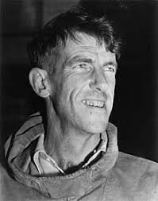
E-(Sir) Edmund Hillary
New Zealand mountaineer and explorer. He was the first person to climb the world's highest mountain along with Tenzing Norgay.

Slide 8
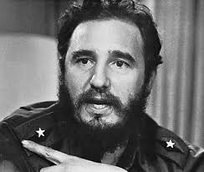
F-Fidel Castro
Fidel Castro was a politician, former Prime Minister and President of Cuba. He died in Havana in 2016.

Slide 9
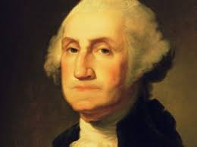
G-George Washington
George Washington was the first President of the United States of America. He is a founding father and is well known President.

Slide 10
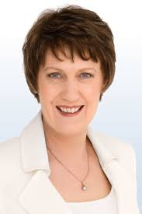
H-Helen Clark
Helen Clark is a New Zealand politician who served as the Prime Minister of New Zealand from 1999 to 2008, and was in the United Nations Development Programme from 2009 to 2017.

Slide 11
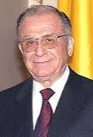
I-Ion Iliescu
Ion Iliescu is a Romanian politician and statesman, who was President of Romania from 1989 until 1996, and from 2000 until 2004

Slide 12
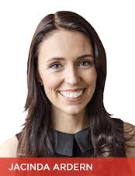
J-Jacinda Ardern
Jacinda Ardern is the new leader of the Labour party. She is running for Prime Minister, with Kelvin Davis as her deputy.

Slide 13
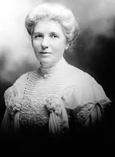
K-Kate Shepherd
Kate Sheppard was the main member of New Zealand's women's suffrage movement and was the country's most famous suffragette. She also appears on our ten-dollar note.

Slide 14
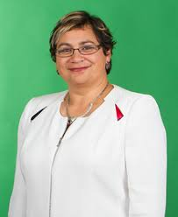
M-Metiria Turei
Metiria Turei recently resigned from the Greens. She was the party leader. She recently admitted to beneficiary and electoral fraud.

Slide 15
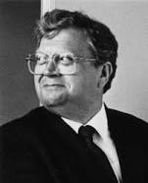
L-David Lange
David Lange served as Prime Minister of New Zealand from 1984 to 1989. He had worked on New Zealand's No Nuclear rule. It is considered as his legacy.

Slide 16
N-Nick Smith
Nick Smith is a Cabinet minister, currently holding the position of Minister for Building and Housing and Minister for the Environment.

Slide 17
O-Osama Bin Laden
Terrorist leader responsible for the devastating attack of 911, that killed thousands of innocent lives. Leader/founder of al-Qaeda.

Slide 18
P-(Sir) Peter Blake
New Zealand environmentalist and strong leader. Also winner of the America cup and wearer of red socks. Peter Blake has a day-red sock day.

Slide 19
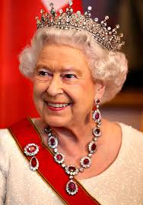
Q-Queen Elizabeth II
British Monarch. Current queen of England and the Commonwealth. She was on our old dollar bills.

Slide 20
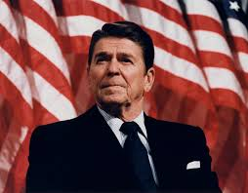
R-Ronald Reagan
Ronald Reagan was an American politician and actor who served as the 40th President of the United States from 1981 to 1989.

Slide 21
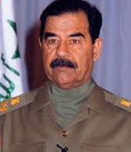
S-Saddam Hussein
Saddam Hussein was a very strong leader and powerful dictator. He was in control of Iraq. He was found and shot in a hole because he was being hunted.

Slide 22
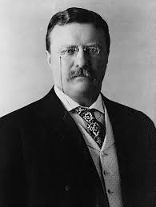
T-Theodore Roosevelt
Theodore Roosevelt was an American author, explorer, soldier, naturalist, and reformer who was a former President of the United States of America. He can be confused with Franklin Roosevelt.

Slide 23
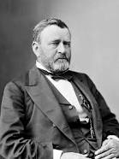
U-Ulysses Grant
Ulysses Grant was the 18th President of the United States. As Commanding General, Grant worked closely with President Abraham Lincoln to lead the Union Army to victory in the American Civil War.

Slide 24
V-Vladimir Putin
Vladimir Putin is the current Prime Minister of Russia. He has heavily been involved with Trump and is in charge of a large country.

Slide 25
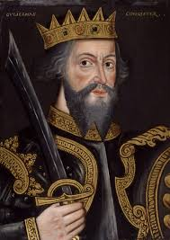
W-William the Conqueror
William I was the first Norman king of England.

Slide 26
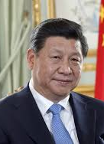
X-Xi Xingping
Xi Xingping is the current President of China. He is in charge of one of the largest exporters in the world.

Slide 27
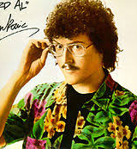
Y-Weird al Yankovic
I couldn't find much more so I put in Yankovic because he took charge in parodies and furthering music.

Slide 28
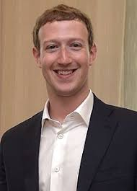
Z-Mark Zuckerberg
Mark Zuckerberg is a famous person who made facebook. He has shown the world social media and others followed in his footsteps creating their own versions: instagram and snapchat etc.

Slide 29
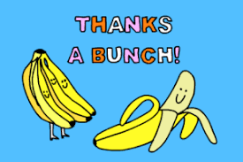
Thanks for watching!

